Slide 1


The Apple Inc
The Apple Inc
"Think different."

Slide 2

Speaker
Introduction
Speaker's Name : Began John
Title: Innovating The World

Slide 3
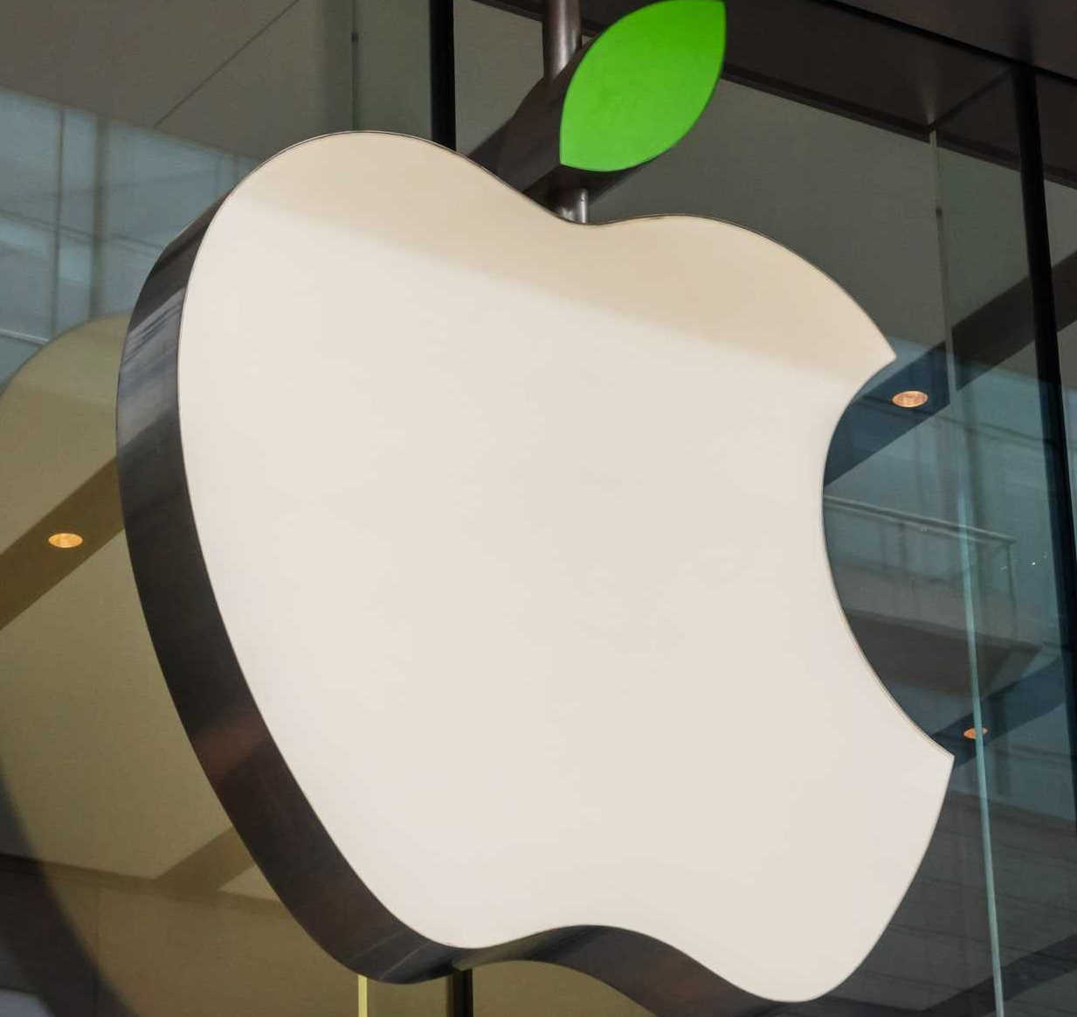
The Apple Inc
Introduction
Apple's relentless innovation has transformed the world, shaping industries and how people interact with technology. From the Macintosh to the iPhone and beyond, its iconic products and user-centric design have set benchmarks, inspiring a generation of tech companies and revolutionizing the way we live.

Slide 4
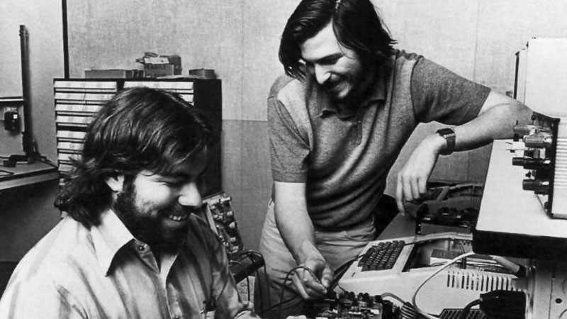
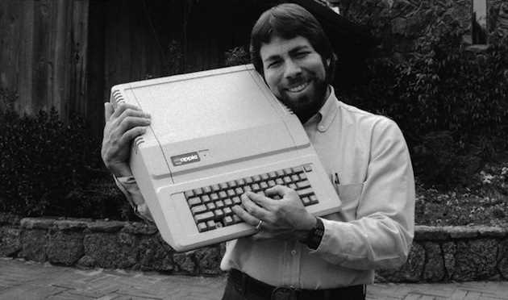
The Apple Inc
History
Founding (1976)
Apple Inc. was founded by Steve Jobs, Steve Wozniak, and Ronald Wayne, with the release of the Apple I computer.
The Apple II (1977)
The Apple II was introduced, becoming one of the first commercially successful personal computers, driving Apple's early success.

Slide 5
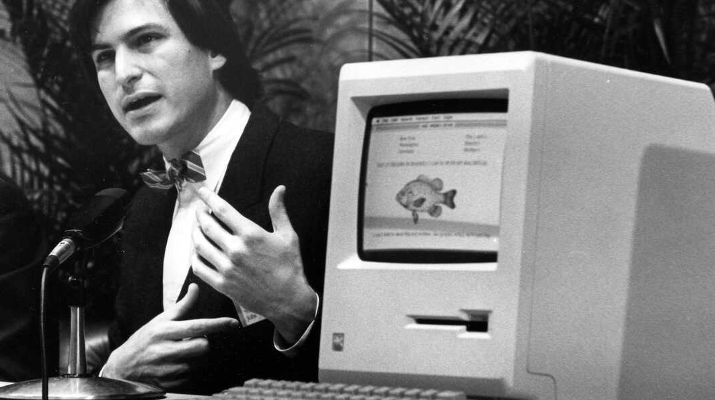
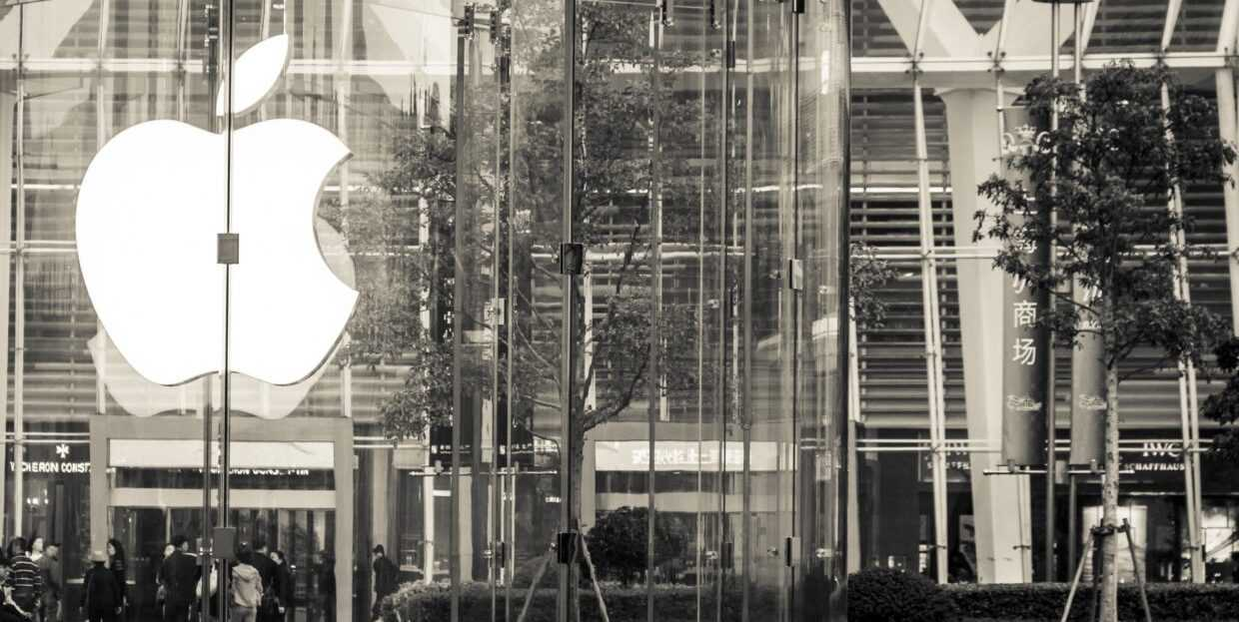
The Apple Inc
History
Macintosh (1984)
The Macintosh, with its graphical user interface, redefined personal computing, making it accessible and user-friendly.
Turbulent Times (1985-1996)
Internal conflicts and declining sales led to Jobs leaving Apple, followed by several leadership changes.

Slide 6
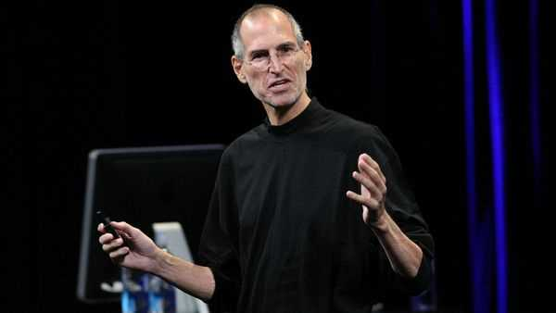
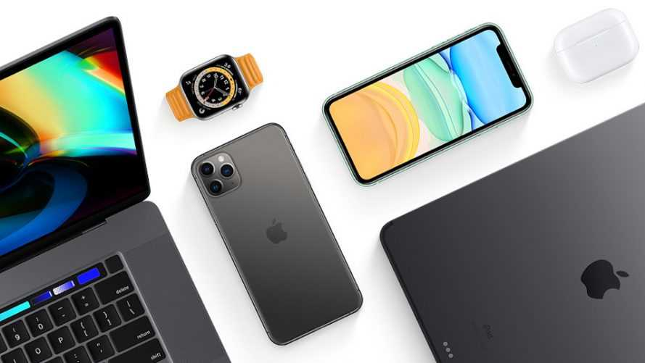
The Apple Inc
History
Return of Steve Jobs (1997)
Steve Jobs returned as CEO, leading Apple's resurgence with iconic products like the iMac, iPod, iPhone, and iPad.
Modern Innovations (2000s-present)
Apple continued its innovation, expanding its ecosystem with iOS devices, services, and the App Store, solidifying its position as a global tech leader.

Slide 7

The Apple Inc
Founding of Apple Inc.
Apple Inc. is a leading American technology company founded in 1976 by Steve Jobs, Steve Wozniak, and Ronald Wayne. It is renowned for its innovative products such as the iPhone, iPad, and Mac, as well as its software and services like iOS, macOS, and the App Store. With its relentless focus on design, user experience, and seamless integration, Apple has become one of the most valuable and influential companies in the business world. Its impact on consumer electronics, software development, and the overall tech industry has been transformative, setting new standards and inspiring competitors to strive for excellence.

Slide 8



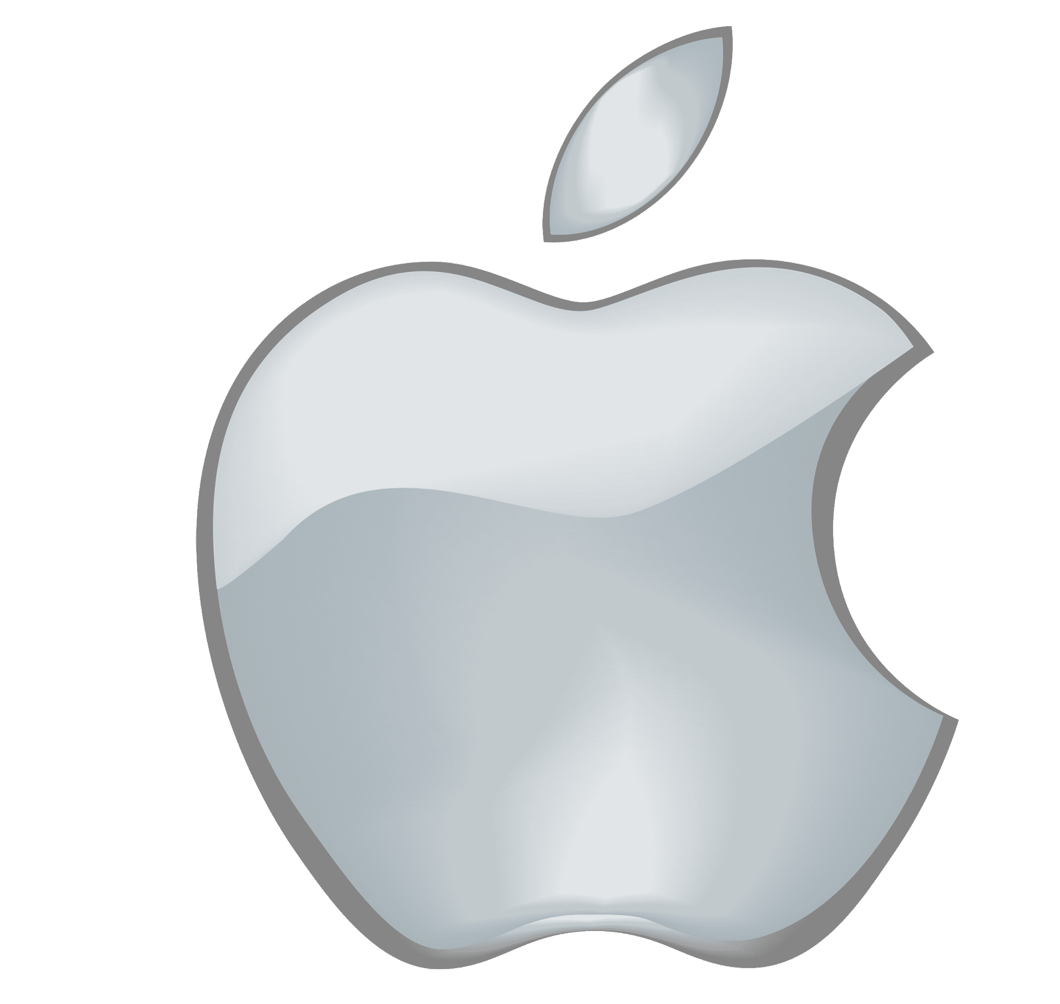

The Apple Inc
Apple Logo History
1976
1998
2007
1977
2001
Current

Slide 9
The Apple Inc
Early Successes And Struggles In Apple
Early Successes
Struggles
Revival
Return of Steve Jobs, iMac's success, iPod's music revolution, iPhone and iPad's dominance in the consumer electronics market.
Apple I and Apple II's popularity, Macintosh's groundbreaking GUI.
Departure of Steve Jobs, declining market share, failed product launches.

Slide 10
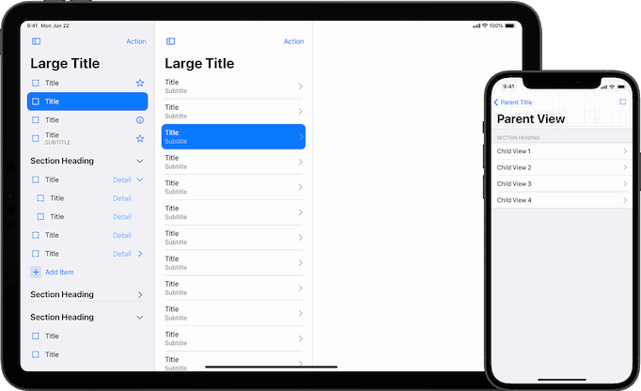
The Apple Inc
Innovation And Breakthroughs
Graphical User Interface (GUI)
With the introduction of the Macintosh in 1984, Apple popularized the graphical user interface, making computers more user-friendly and accessible to the masses.

Slide 11

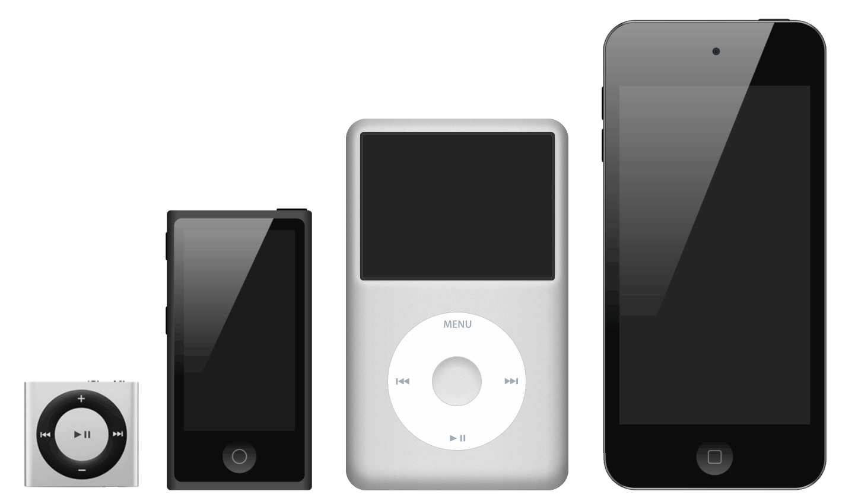


The Apple Inc
Innovation And Breakthroughs
iMac Design
iPod And iTunes
iPhone and
Multi-Touch Interface
App Store

Slide 12
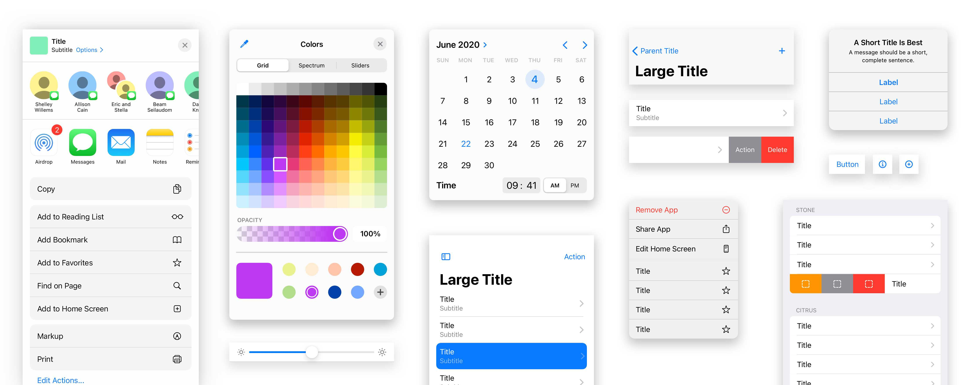
The Apple Inc
Design And User Experience
Apple excels in minimalistic design, intuitive interfaces, seamless integration, and human-centered approach for an exceptional user experience.
Minimalist Design
User-Centric Approach
Intuitive Interface
Seamless Integration
Human-Centered Design
Retina Display
Gestures and Multi-Touch
Siri and Voice Interaction
Haptic Feedback
Continuity and Handoff
Accessibility

Slide 13
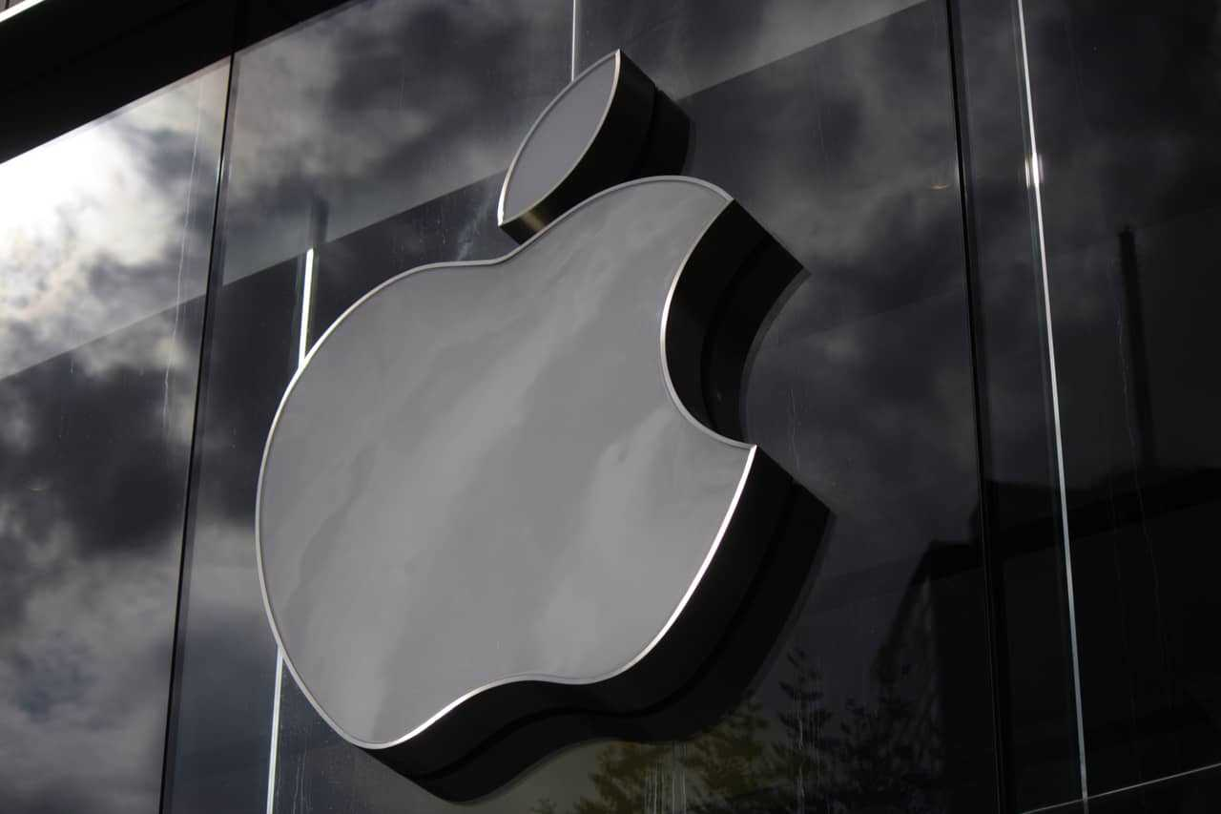
The Apple Inc
Branding And Marketing Strategies
Branding Strategy: Create a unique, emotional brand identity that reflects innovation, quality, and lifestyle to differentiate from competitors.
Marketing Strategy: Employ emotional storytelling, iconic product launches, and social media engagement to build a devoted customer base and drive sales.

Slide 14
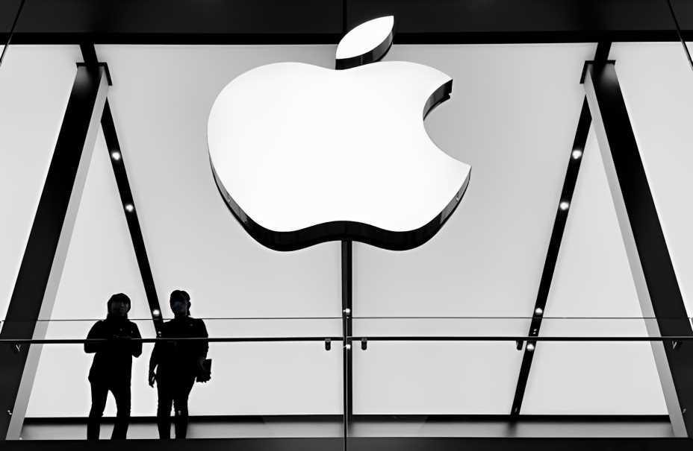
The Apple Inc
Apple Stores And Retail Strategy
Apple Stores
Retail Strategy
Iconic, minimalist design with a focus on customer experience, product interaction, and personalized assistance to enhance brand loyalty.
Establish flagship stores globally, offering a premium, immersive shopping experience, building brand loyalty, and promoting cross-device ecosystem integration.

Slide 15
The Apple Inc
Financial Success

Slide 16
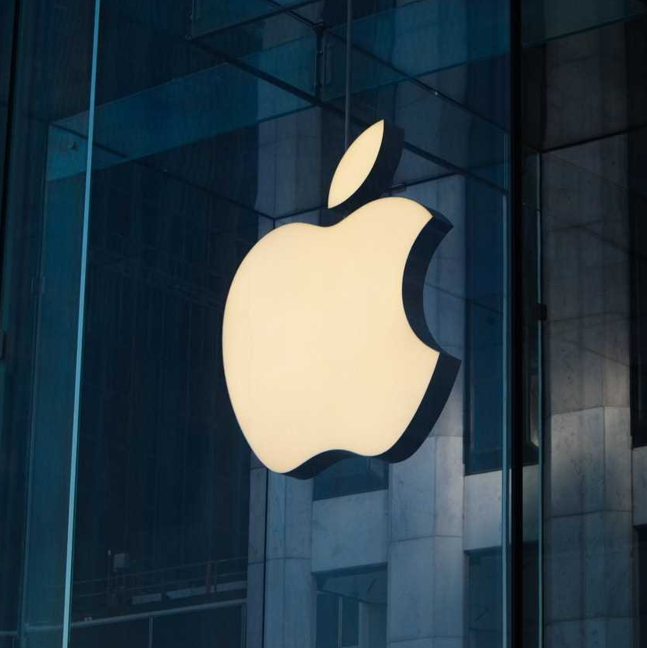
The Apple Inc
Business Resurgence
After Steve Jobs' return in 1997, Apple's business resurgence was fueled by a series of innovative products, including the iMac, iPod, and iPhone, coupled with a design-centric approach and seamless ecosystem integration, leading to remarkable success and growth.

Slide 17
The Apple Inc
Impact On Industries
Mobile Communication
Music
Distribution
Computing
Publishing
Consumer Electronics

Slide 18
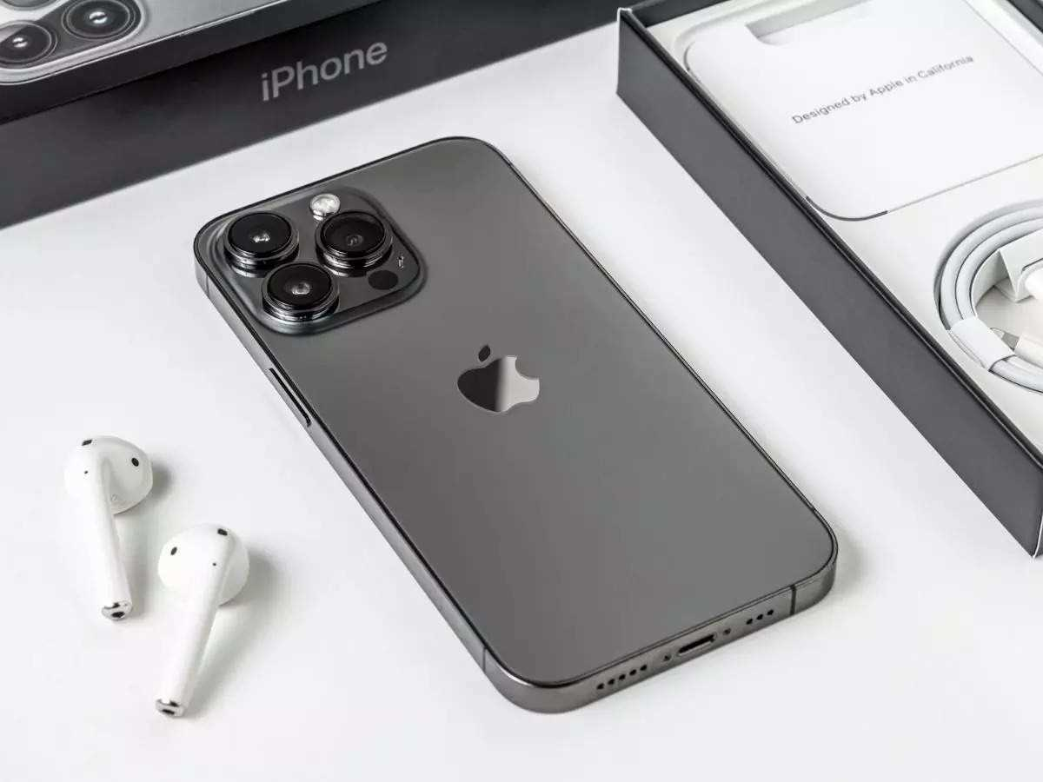
The Apple Inc
Lessons Learned
Apple's success highlights the importance of relentless innovation, prioritizing user experience through intuitive design and seamless integration. By focusing on creating products that delight customers, Apple forged an emotional connection, fostered brand loyalty, and remained a dominant force in the tech industry.

Slide 19
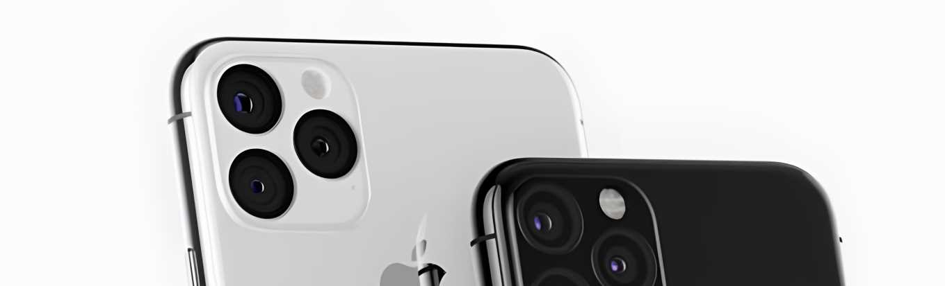
The Apple Inc
Conclusion
Apple's success stems from innovation, user experience focus, and visionary leadership. Pioneering products like iPhone and iPad revolutionized industries, building a loyal customer base. A testament to effective branding, marketing, and organization effectiveness, inspiring businesses globally.

Slide 20

The Apple Inc
Thank You….
Contact Information
Email: Beganjohn@example.com
Website: www.Beganjohn.com

Slide 21
Icons

Slide 22
Icons

Slide 23
How To Edit Shapes
You can add and edit some shapes to your presentation to present your data in a visual way.
Choose your favourite infographic and insert it in your presentation using Ctrl C + Ctrl V or Cmd C + Cmd V in Mac.
Select one of the parts and ungroup it by right-clicking and choosing “Ungroup”.
Change the color by clicking on the paint bucket.
Then resize the element by clicking and dragging one of the square-shaped points of its bounding box (the cursor should look like a double-headed arrow). Remember to hold Shift while dragging to keep the proportions.
Group the elements again by selecting them, right-clicking and choosing “Group”.
Repeat the steps above with the other parts and when you’re done editing, copy the end result and paste it into your presentation.
Remember to choose the “Keep source formatting” option so that it keeps the design. For more info, please visit Slideegg (Tips & Tricks).

Slide 24
Terms Of Use (Free Users)
If you are a free subscriber, you should credit SlideEgg by keeping the “Thank You” slide.
Kindly refer to the following slide for the Terms of Use for premium users.
You can:
Customize or edit this template
Use this template for both business and personal endeavors.
You can not:
Sell, rent, or second-license SlideEgg content or its altered version.
Promulgate, unless explicitly permitted, SlideEgg content, by SlideEgg.
Incorporate SlideEgg content in any database or file online or offline.
Obtain SlideEgg content’s copyright.
Kindly refer to our Tutorial page or FAQ for advanced slide modification guidelines.

Slide 25
Terms Of Use (Premium Users)
Being a premium subscriber, you have the privilege of using this PPT template
without giving attribution to SlideEgg or keeping the “Thank You” slide.
You can:
Customize or edit this template.
Use this template for both business and personal endeavors.
Circulate or share the editable format of this template with anyone you want.
You can not:
Sell, rent or second-license SlideEgg content or the altered version of it.
Promulgate or include the templates in any other services database
that performs as distribution or resale platform, unless explicitly permitted, by SlideEgg.
Incorporate the elements used in SlideEgg’s templates separately.
Obtain SlideEgg’s copyright for the elements used in this template as a logo or trademark.
Kindly refer to our Tutorial page or FAQ for advanced slide modification guidelines.

Slide 26





Thank You!
We respect your valuable time with SlideEgg!
If you have any questions, please reach us
Do you have a design request, please visit our redesign page.
CREDIT: SlideEgg created this PowerPoint template.
Let this slide be kept for attribution.
www.slideegg.com

